Slide 1
Analysis and Integration of High Throughput Data Types for Insights into Complex Disease
-- in collaboration with Prof. G Mann’s
(Sydney Medical School)
Jean Yee Hwa Yang
School of Mathematics and Statistics
Notes:
Vivek Jayaswal <jayaswalvivek@yahoo.com>

Slide 2



Interdisciplinary research
Proteomics research unit
- Ben Crossett-
- Swetlana Mactier
- Richard Christopherson
University of Sydney
Mathematics and statistics
Ellis Patrick
Samuel Müller
Kaushala Jayawardana
Shila Ghazanfar
Dario Strbenac
Penghao Wang (CSIRO)
Anna Campain
Vivek Jayaswal
John Ormerod
Melanoma program at
MIA/WMI/RPA
Graham Mann
John Thompson
Sarah-Jane Schramm
Gulietta Pupo
Svetlana Pianova
Varsha Tembe
Lauren Haydu
Tumour bank and pathology
Richard Scolyer
Cadance Carter
Chitra De Silva
Ken Lai
James Wilmott

Slide 3
Research aims
84 Stage III
Melanoma specimens
New prognostic markers
To determine whether there are significant biomarker and pathway differences between melanomas of good and bad prognosis after resection of nodal metastatic disease;
New therapeutic targets
To identify and validate the principal regulatory pathway abnormalities that characterise metastatic (stage III and IV) melanomas;
To investigate novel genomic drivers of melanoma tumour progression and outcome.
DNA
SNP array / Exome-seq
DNA-seq
RNA
mRNA array / microRNA
RNA-seq
Protein / Metabolic
iTRAQ / MS/MS
Phenotype
Clinical and pathological data
Notes:
I’ve written the specific research aims on this slide but the upshot is that I’m looking for new prognostic markers and new therapeutic targets in stage III melanoma.
So, can cancer systems biology help?

Slide 4
Vertical integration
Question specific and translation focus integration
DNA
SNP array / Exome-seq
DNA-seq
RNA
mRNA array / microRNA
RNA-seq
Protein / Metabolic
iTRAQ / MS/MS
Phenotype
Clinical and pathological data

Slide 5
Vertical integration
Question specific and translation focus integration
Using network features as biomarker and we found that some individual sub-networks (from PPI) are capable of separating the classes reasonably well.
DNA
SNP array / Exome-seq
DNA-seq
PPI
network
RNA
mRNA array / microRNA
RNA-seq
Protein / Metabolic
iTRAQ / MS/MS
Phenotype
Clinical and pathological data

Slide 6
Vertical integration
Examples of question specific and translation focus integration
Using network features as biomarker and we found that some individual sub-networks (from PPI) are capable of separating the classes reasonably well.
pMimCor: Identify groups of genes that are being regulated by a miRNA and share some common biological function. Provide a joint ranking of genes and miRNAs.
DNA
SNP array / Exome-seq
DNA-seq
Pathways
RNA
mRNA array / microRNA
RNA-seq
Protein / Metabolic
iTRAQ / MS/MS
Phenotype
Clinical and pathological data

Slide 7
Vertical integration
Examples of question specific and translation focus integration
Using network features as biomarker and we found that some individual sub-networks (from PPI) are capable of separating the classes reasonably well.
pMimCor: Identify groups of genes that are being regulated by a miRNA and share some common biological function. Provide a joint ranking of genes and miRNAs.
Identify the relationship between PPI network disturbances and functional mutation burden score
DNA
SNP array / Exome-seq
DNA-seq
PPI
network
RNA
mRNA array / microRNA
RNA-seq
Protein / Metabolic
iTRAQ / MS/MS
Phenotype
Clinical and pathological data

Slide 8
Vertical integration
Examples of question specific and translation focus integration
Using network features as biomarker and we found that some individual sub-networks (from PPI) are capable of separating the classes reasonably well.
pMimCor: Identify groups of genes that are being regulated by a miRNA and share some common biological function. Provide a joint ranking of genes and miRNAs.
Identify the relationship between PPI or protein expression network disturbances and functional mutation burden score
DNA
SNP array / Exome-seq
DNA-seq
RNA
mRNA array / microRNA
RNA-seq
Protein / Metabolic
iTRAQ / MS/MS
Phenotype
Clinical and pathological data

Slide 9
Patient accuracy
45 samples (excluding protein data)
GP
PP
Clinical_AJCC
CPM
mRNA
microRNA
CPM + mRNA
CPM + microRNA
Samples
Clinical_AJCC = 4 AJCC variables: 1. Ulceration, 2. thickness of the primary tumour, 3. number of metastatic nodes and 4. nodal size.
Jayawardana K et al, IJC, 2014
9

Slide 10
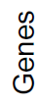

Motivating simulation example
Majority class is better classified
GP
PP
Major
Minor
Major
Minor
Notes:
n = 100,
p = 15
The color code is showing the expected expression level – for simplicity let’s assume that information in the genes has signals between -0.5 and 0.5 (normal with sd = 0.5)

Slide 11
Motivating simulation example I
GP
PP
Major
Minor
Major
Minor
Major
group
Notes:
n = 100,
p = 15
The color code is showing the expected expression level – for simplicity let’s assume that information in the genes has signals between -0.5 and 0.5 (normal with sd = 0.5)

Slide 12
Motivating simulation example I
GP
PP
Major
Minor
Major
Minor
Major
group
Minor group
Notes:
n = 100,
p = 15
The color code is showing the expected expression level – for simplicity let’s assume that information in the genes has signals between -0.5 and 0.5 (normal with sd = 0.5)

Slide 13
Motivating simulation example I
GP
PP
Major
Minor
Major
Minor
Major
group
Minor group
Classification
+ CV estimation
Classification
+ CV estimation
Notes:
n = 100,
p = 15
The color code is showing the expected expression level – for simplicity let’s assume that information in the genes has signals between -0.5 and 0.5 (normal with sd = 0.5)

Slide 14
Motivating simulation example I
Two classifiers are better than one
Major
group
Minor group
Classification
+ CV estimation
Classification
+ CV estimation
Notes:
n = 100,
p = 15
The color code is showing the expected expression level – for simplicity let’s assume that information in the genes has signals between -0.5 and 0.5 (normal with sd = 0.5)

Slide 15
Motivating simulation example I
GP
PP
Major
Minor
Major
Minor
Notes:
n = 100,
p = 15
The color code is showing the expected expression level – for simplicity let’s assume that information in the genes has signals between -0.5 and 0.5 (normal with sd = 0.5)

Slide 16
Motivating simulation example II
GP
PP
Major
Minor
Major
Minor
Notes:
n = 100,
p = 15
The color code is showing the expected expression level – for simplicity let’s assume that information in the genes has signals between -0.5 and 0.5 (normal with sd = 0.5)

Slide 17
Patient accuracy
45 samples (excluding protein data)
GP
PP
Clinical_AJCC
For every patient we can count how often we classify the patient incorrectly
Patient specific error
Hard vs easy samples
CPM
mRNA
microRNA
CPM + mRNA
CPM + microRNA
Samples
Clinical_AJCC = 4 AJCC variables: 1. Ulceration, 2. thickness of the primary tumour, 3. number of metastatic nodes and 4. nodal size.
Jayawardana K et al, IJC, 2014
17

Slide 18
Finding interaction
y = number of correctly classified bootstrap samples under the mRNA (gene expression) platform
Design matrix X takes values from clinical variables.
Variable | Estimate | SD | t | p-value
Intercept | 0.23 | 0.76 | 2.98 | 0.005
Extranodal growth (Tum_Extranodal) | 0.37 | 0.12 | 3.22 | 0.002
Number of invasive nodes (Tum_Nodes) | -0.02 | 0.01 | -2.04 | 0.050
Notes:
Here (although we should do this differently in the future), using the average classification error as the new y (new response) we run a linear regression (which of course is not ideal and we should have worked on either transformed y’s or using nonlinear regression models) and run forward stepwise with AIC. Extranodal is dichotomous and Number of invasive nodes is integer valued 0 to 10+

Slide 19
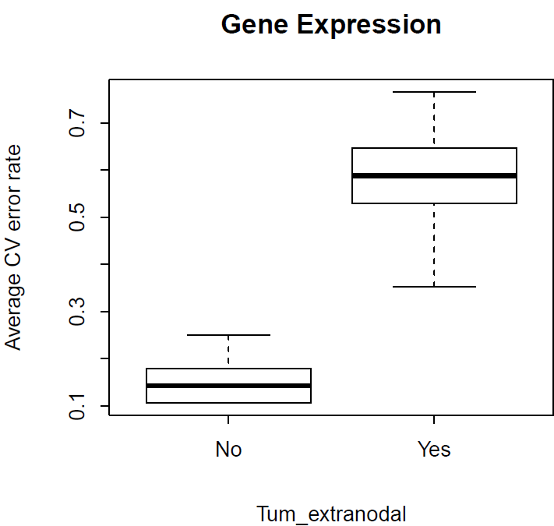
Looking for interactions (features) between platforms
CV error rates for samples with or without Tum_Extranodal
Tum_Extranodal
Tum_Extranodal
Notes:
Suggests no sub groups and minimal mislabelling
Going back to the rowmeans, however, classification is based on only those patients (samples) who had Tum_extranodal = No in the left boxplot and yes in the right.
The boxplot is for 100 5-fold-CV repeats to classify into GP and PP.
Because of the different behaviour, we see now clearly that Tum_extranodal should be used as a interaction term when combining it with either Gene Expression or CPM.
If we had a reduction in CV error in both boxplots within Gene Expression say, then it is clear that we need to have two different classifiers for the No and Yes patients respectively, i.e. an interaction term within Gene expression

Slide 20
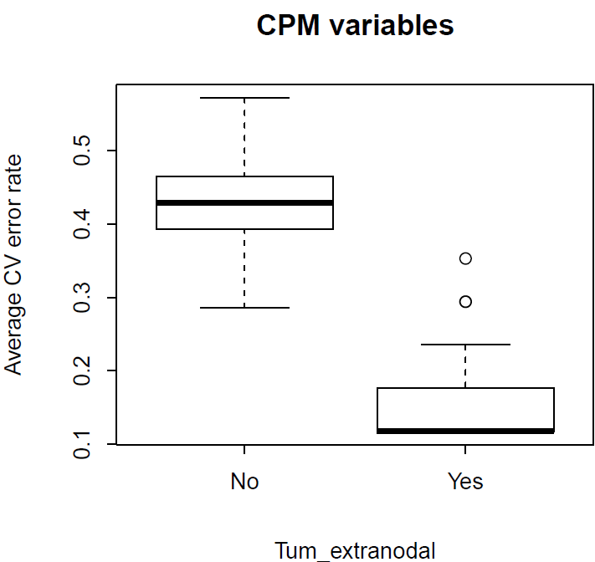
Looking for interactions (features) between platforms
CV error rates for samples with or without Tum_Extranodal
Tum_Extranodal
Tum_Extranodal
Notes:
Suggests no sub groups and minimal mislabelling
Going back to the rowmeans, however, classification is based on only those patients (samples) who had Tum_extranodal = No in the left boxplot and yes in the right.
The boxplot is for 100 5-fold-CV repeats to classify into GP and PP.
Because of the different behaviour, we see now clearly that Tum_extranodal should be used as a interaction term when combining it with either Gene Expression or CPM.
If we had a reduction in CV error in both boxplots within Gene Expression say, then it is clear that we need to have two different classifiers for the No and Yes patients respectively, i.e. an interaction term within Gene expression

Slide 21
Where has this lead us?
Hierarchical two stage procedure
Easy
Hard
In practice:
Use readily available CPM variables for the tumors with extranodal growth (Tum_Ext) to split samples.
Perform classification based on gene expression for tumors without extranodal growth (Tum_Extranodal = NO)
Clinical
variables
?
Patients
PP
GP
Use other molecular platforms?
Surgical or treatment related data?
mRNA

Slide 22
How do we compare error rate ?

Slide 23
How do we compare error rate ?
gene
Clinical
Two-stage

Slide 24
Melanoma data

Slide 25
Breast cancer data
Public data from E-TABM-158 (Chin et al, 2006)
Affymetrix HT-U133AA of Av2 GeneChip
Stage II patients
GP: less than 5 years (n = 18)
PP: greater thann 5 years (n = 31)

Slide 26
Interdisciplinary research
Proteomics research unit
- Ben Crossett-
- Swetlana Mactier
- Richard Christopherson
University of Sydney
Mathematics and statistics
Ellis Patrick
Samuel Müller
Kaushala Jayawardana
Shila Ghazanfar
Dario Strbenac
Penghao Wang (CSIRO)
Anna Campain
Vivek Jayaswal
John Ormerod
Melanoma program at
MIA/WMI/RPA
Graham Mann
John Thompson
Sarah-Jane Schramm
Gulietta Pupo
Svetlana Pianova
Varsha Tembe
Lauren Haydu
Tumour bank and pathology
Richard Scolyer
Cadance Carter
Chitra De Silva
Ken Lai
James Wilmott

Slide 28
How do we compare error rate ?
Cross-validating feature selection method is important

Slide 29
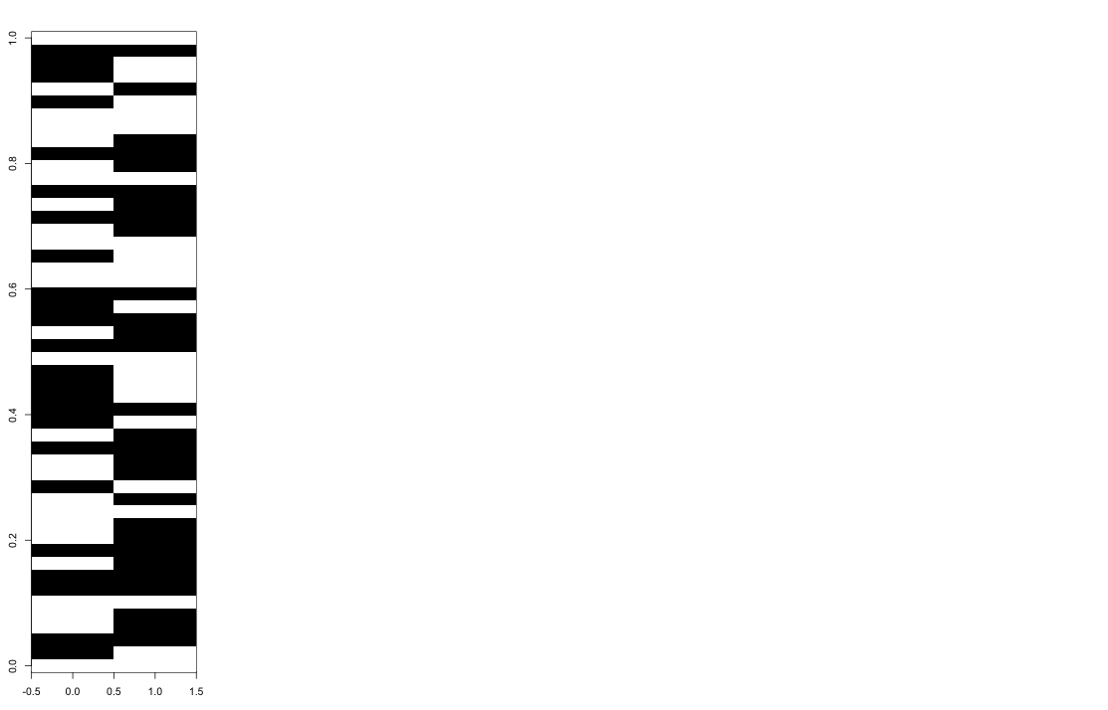
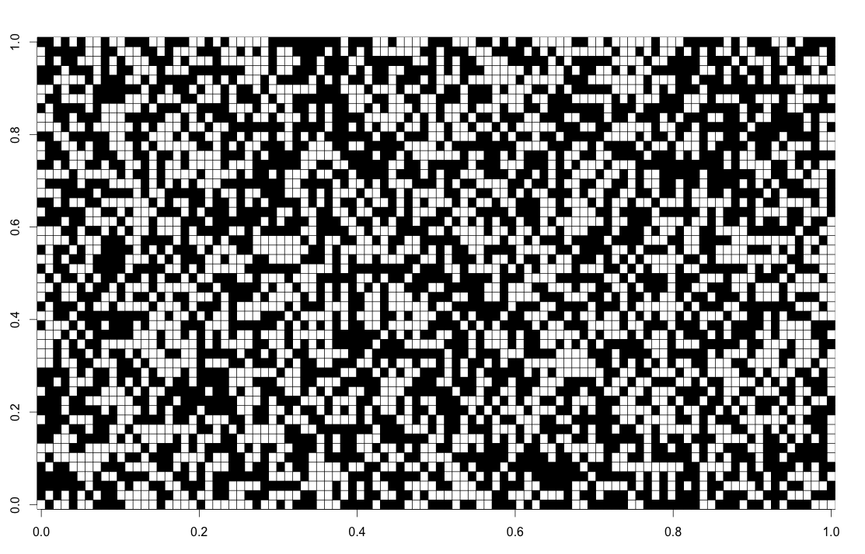
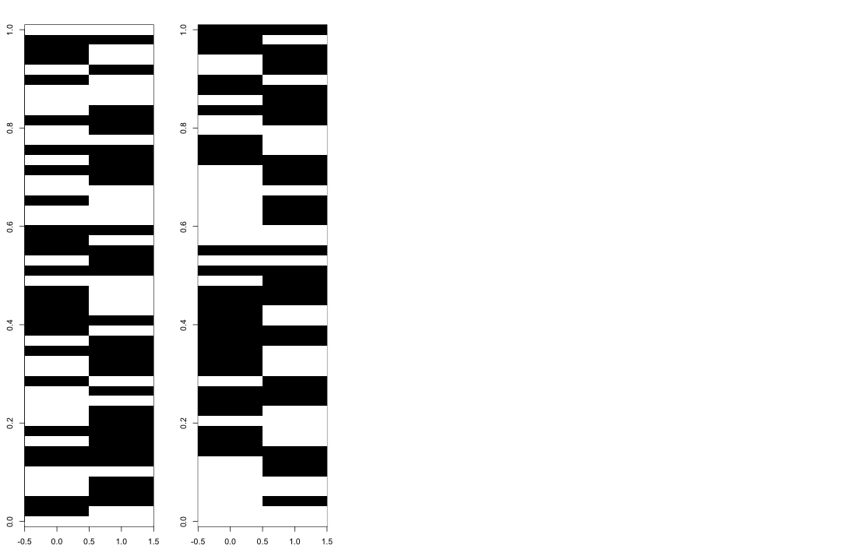
Average 5-fold cross validation
resample
Patients
5-fold CV
Patients
CV errors
Patients
5-fold CV
Genes
100 resamples
5-fold CV
Learning set
Testing set
Notes:
Here Black = Classified wrongly
White = Classified correctly
Let’s think about understanding why certain columns are predominantly black, white and why are some mixed: Sample = column.
Conjecture: samples that are consistently misclassified (shown in white) could belong to some minority group

Slide 30
Average 5-fold cross validation
resample
Patients
5-fold CV
Patients
Patients
5-fold CV
Genes
100 resamples
5-fold CV
Average patient
accuracy
Learning set
Testing set
Notes:
Here Black = Classified wrongly
White = Classified correctly
Let’s think about understanding why certain columns are predominantly black, white and why are some mixed: Sample = column.
Conjecture: samples that are consistently misclassified (shown in white) could belong to some minority group

Slide 31
Samples that are hard to classify
resample
Patients
5-fold CV
Patients
Patients
5-fold CV
For every patient we can count how often we classify the patient incorrectly
Patient specific error
Hard vs easy samples
Genes
100 resamples
5-fold CV
Average patient
accuracy
Learning set
Testing set
Notes:
Here Black = Classified wrongly
White = Classified correctly
Let’s think about understanding why certain columns are predominantly black, white and why are some mixed: Sample = column.
Conjecture: samples that are consistently misclassified (shown in white) could belong to some minority group

Slide 32
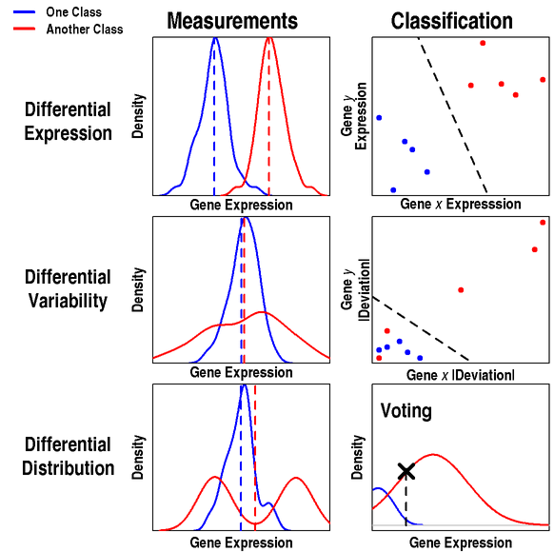
Different measures
Dashed coloured lines : Mean of each class.
Dashed black lines : Separating hyperplane (not calculated by a classifier, but imagined).
Dario Strbenac
Dr. John Ormerod

Slide 33
Integration with pre-validation
Individual platform
Clinical: CPM
G: mRNA
P: protein
M: microRNA
Integration through
pre-validation
CPM + G
CPM + P
CPM + M
CPM + G + P + M
5-fold CV error rate
Jayawardana K et al, IJC, 2014

Slide 34
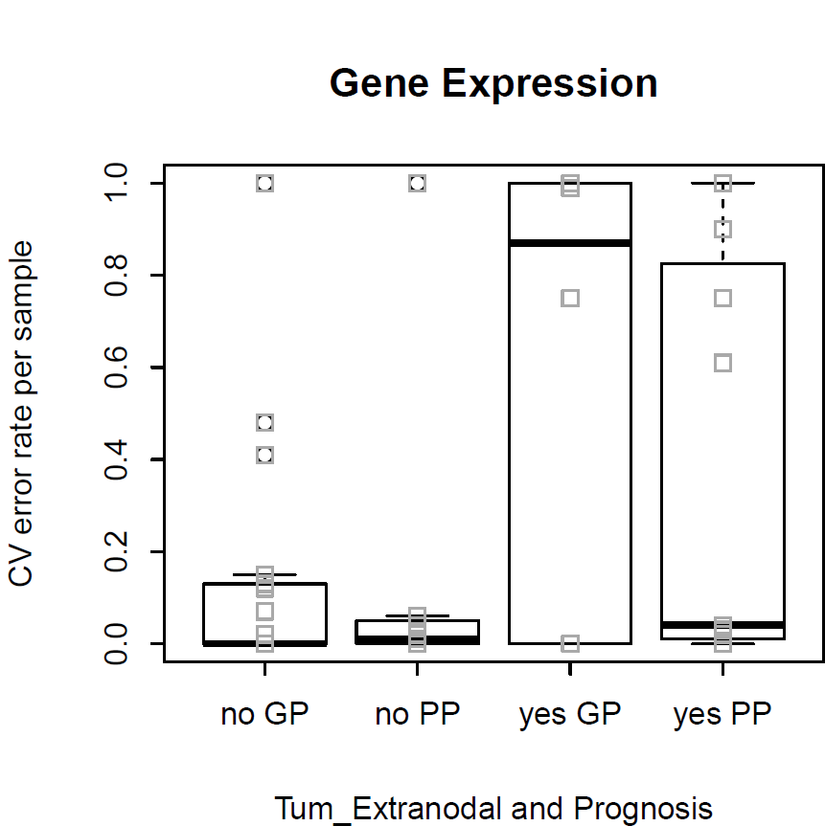
‘Hard’ and ‘Easy’ to classify samples
Patient specific error rate
Tum_Extranodal
(No)
Tum_Extranodal
(Yes)

Slide 35
Motivating simulation example II
GP
PP
Major
Minor
Major
Minor
Notes:
n = 100,
p = 15
The color code is showing the expected expression level – for simplicity let’s assume that information in the genes has signals between -0.5 and 0.5 (normal with sd = 0.5)

Slide 36
Motivating simulation example II
Majority class is better classified

Slide 37
Experimental data
84 Stage III
Melanoma specimens
GP: < 1 year died due to melanoma
PP: > 4 year with no sign of relapse
CPM
-omics data
Clinico-pathologic
(n = 48)
BRAF / NRAS
Mutation status
(n = 48)
mRNA expression
(n = 47)
microRNA expression
(n = 45)
Protein (iTRAQ) expression
(n = 33)*
19 variables
2 variables
48802
probes
1347 sets of probes
8397 peptides
Due to limited sample, re-inclusion of 9 samples
Notes:
mRNA : data not available
miRNA : 2 insufficient tissue.

Slide 38
Challenges in “vertical” integration
Small number of samples (large p, small n).
Sample mismatch (limited amount of tissues).
Understanding and processing many different platforms.
Correlated information from multiple platforms.
Unbalanced number of variables between CPM and high throughput -omics platforms.

Slide 39
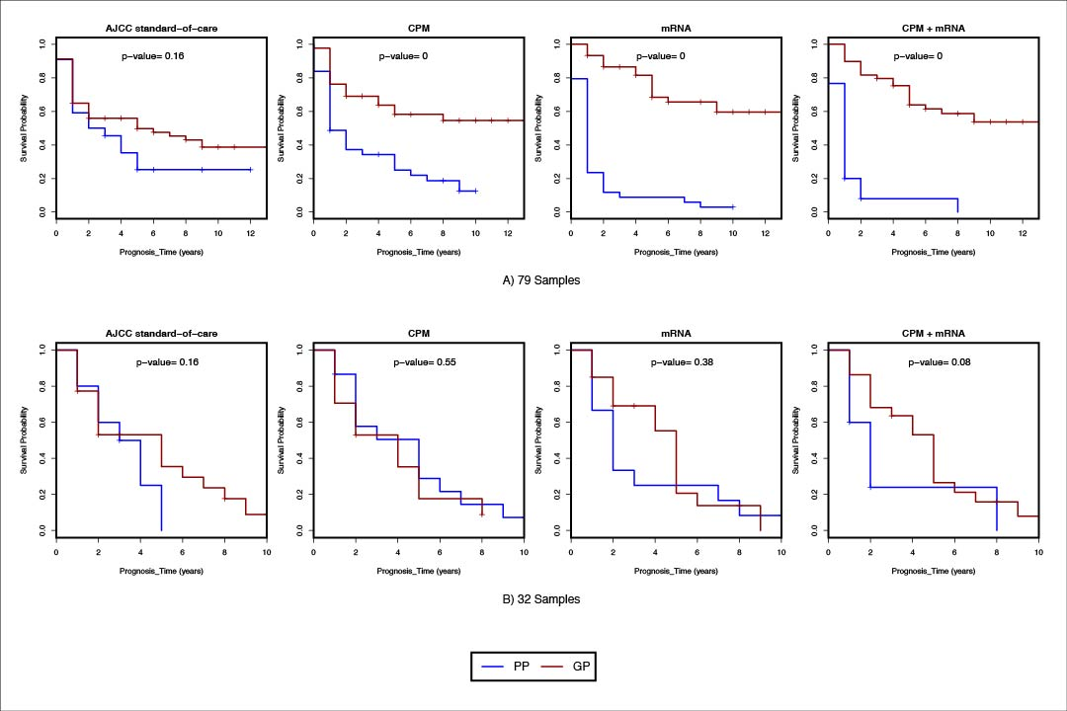
Validation in independent samples
AJCC
CPM
mRNA
CPM + mRNA
79 samples
32 samples
Jayawardana K et al, IJC, 2014
Notes:
Previously we have shown that that the integrated (CPM and mRNA) classifier performed better than the classifiers that were based on individual platforms alone.
Using our original cohort and in the 32 independent samples.
We have now shown that integrating multiple ‘-omics’ platforms improves classification above AJCC standard-of-care variables as well.
As illustrated, the p-values from the log-rank test for the integrated
classifier (n=79, p-value=6.95x10-13; n=32, p-value=0.0761) are much lower than the p-values from the AJCC standard-of-care classifier in both scenarios (n=79, p-value=0.157; n=32, p-value=0.164).

Slide 40
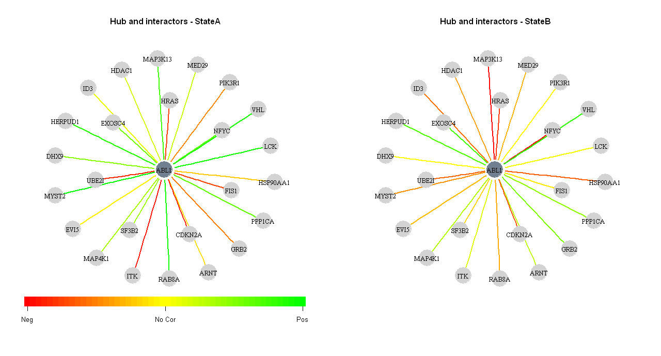
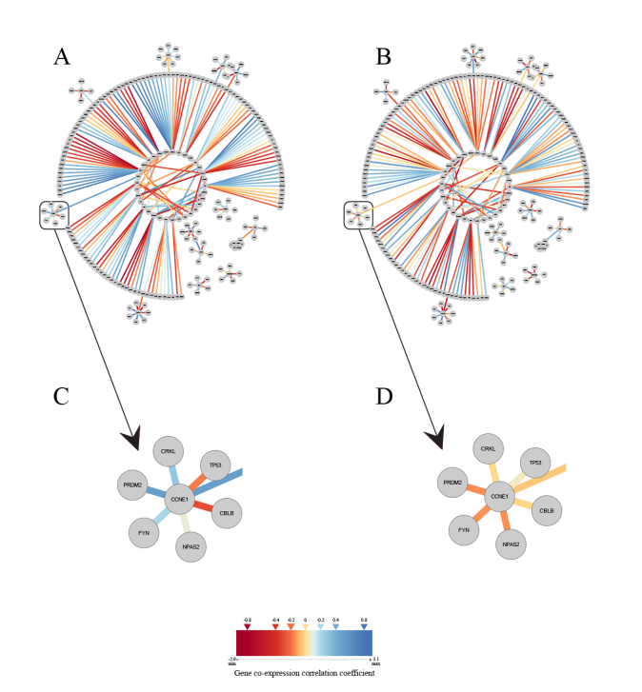
Software available
VAN: identifying biologically perturbed networks using differential variability analysis
BMC RES. NOTES.|Under review|2013,
Notes:
VAN is an R-software package that will take your transcriptomics data and combine it with PPI network information to identify network-based differences between 2 or more conditions of interest, including time series data. Unpublished but available for use on request and comes with a user guide that tries to make it accessible to non-programmers.
Users can select any network they like to organise the expression data. However, we are currently using a gold-standard reference set in the Human Interactome 2012 Prepublication data set (HI-2012 Prepublication) from Center for Cancer Systems Biology (CCSB) at Dana-Farber Cancer Institute. “~14,000 novel binary interactions derived from yeast two-hybrid screens over a search space corresponding to a matrix of ~13,000 x 13,000 proteins. This search space represents ~35% of the complete search space, assuming a total of ~22,000 protein-coding genes and limiting the scope to one variant per gene. Early release of data from these high-throughput screens is now available (HI-2012 Prepublication), and data analysis is ongoing.”

Slide 41
Protein or gene expression data + PPI
Some individual sub-networks are capable of separating the classes reasonably well, by considering the difference between hub and average interactors expression.
Barter R et al, BMC System Biology, 2014

Slide 42
PPI network disturbances and functional mutation burden score
Gene expression data
Exome-seq mutation data
Sample selection based on survival cutoffs
FMB score calculation
PPI networks
Disturbed hub subnetworks
Hubs having interactors with significant FMB
score
Network association test
Ghazanfar, S and Schramm et al (in preparation)

